Slide 1
Learning Objective
I will be able to apply the quotient rule
Success Criteria
At the end of the lesson, I will be able to:
Examine and use the quotient rule

Slide 2
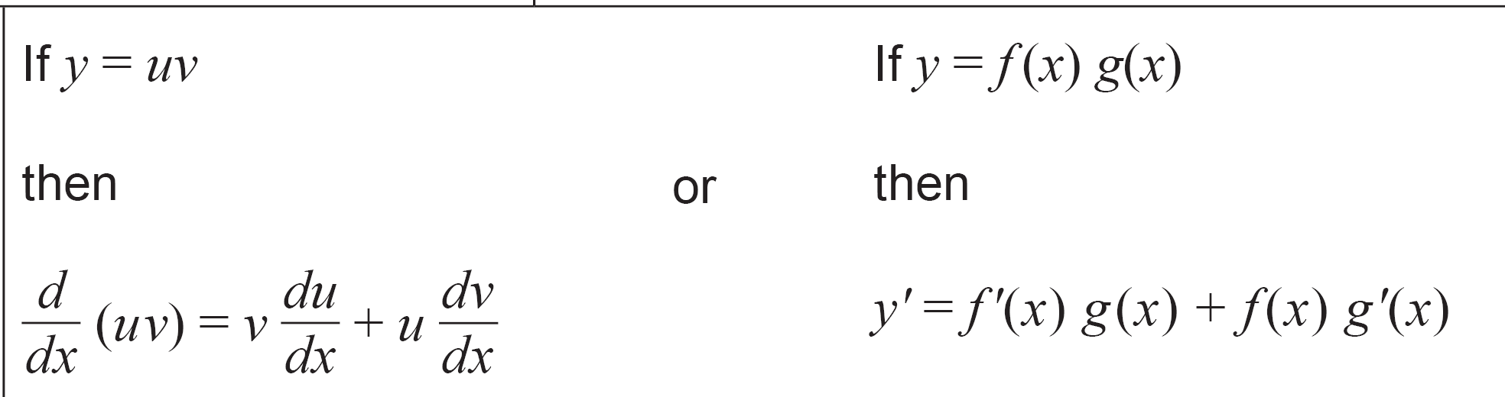

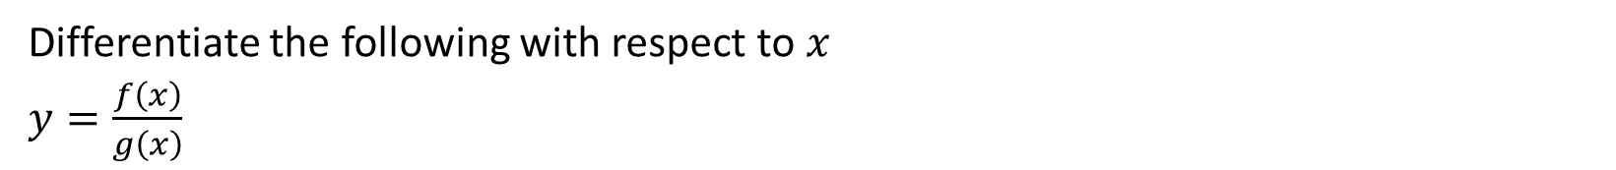
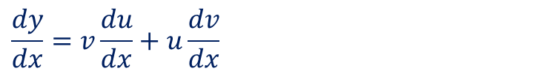


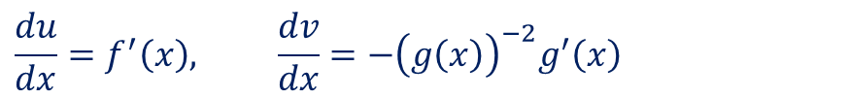
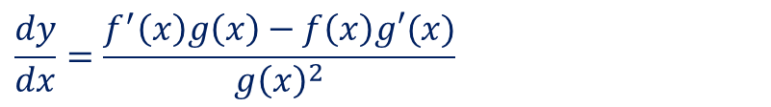
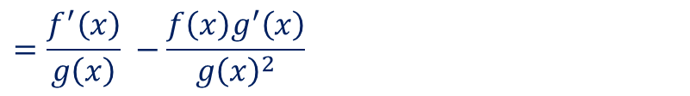
Guided Practice
Differentiate the following with respect to $x$
$y=\frac{f\left(x\right)}{g\left(x\right)}$
How would this be represented in Leibniz notation?
Rewrite $y=f(x){\left(g\left(x\right)\right)}^{−1}$
Let $u=f(x), v={\left(g\left(x\right)\right)}^{−1}$
If $y=\frac{u}{v},$ where $u$ and $v$ are functions of $x$
$$\frac{du}{dx}=f^{′}\left(x\right), \frac{dv}{dx}=−{\left(g\left(x\right)\right)}^{−2}g^{′}\left(x\right)$$
$$\frac{dy}{dx}=\frac{v\frac{du}{dx}−u\frac{dv}{dx}}{v^{2}}$$
$$\frac{dy}{dx}=v\frac{du}{dx}+u\frac{dv}{dx}$$
$$=f′\left(x\right){\left(g\left(x\right)\right)}^{−1}−{\left(g\left(x\right)\right)}^{−2}g^{′}\left(x\right)f(x)$$
$$=\frac{f^{′}\left(x\right)}{g\left(x\right)} −\frac{f\left(x\right)g^{′}\left(x\right)}{g{\left(x\right)}^{2}}$$
$$\frac{dy}{dx}=\frac{f^{′}\left(x\right)g\left(x\right)−f\left(x\right)g′(x)}{g{\left(x\right)}^{2}}$$
(Quotient Rule in function notation)

Slide 3
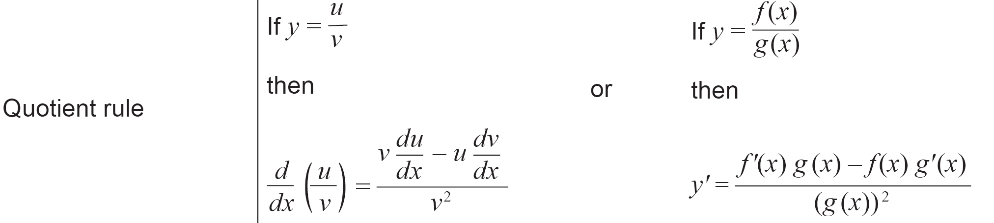

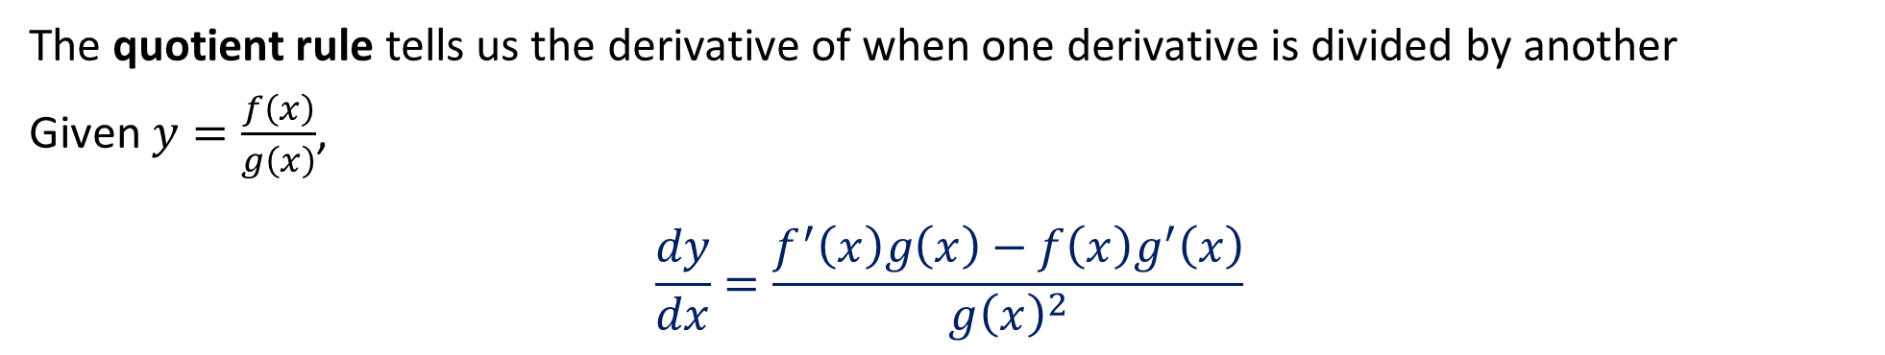

Quotient Rule
The quotient rule tells us the derivative of when one derivative is divided by another
Given $y=\frac{f\left(x\right)}{g\left(x\right)}$,
$$\frac{dy}{dx}=\frac{f^{′}\left(x\right)g\left(x\right)−f\left(x\right)g^{′}\left(x\right)}{g{\left(x\right)}^{2}}$$
(Function Notation)
Given $y=\frac{u}{v},$
$$\frac{dy}{dx}=\frac{v\frac{du}{dx}−u\frac{dv}{dx}}{v^{2}}$$
(Leibniz Notation)
In Formula Sheet:

Slide 4
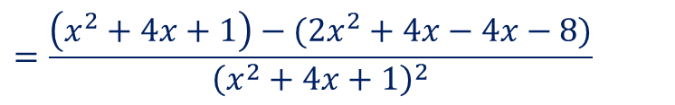
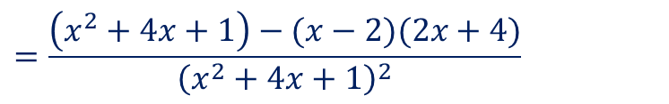
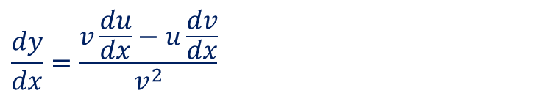

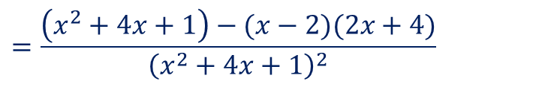
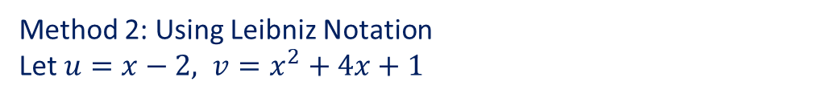
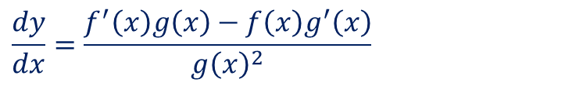
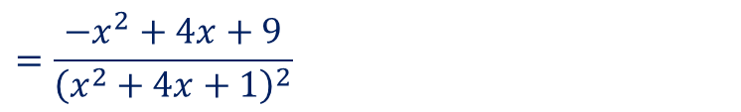
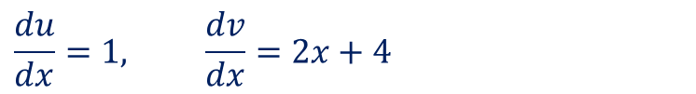
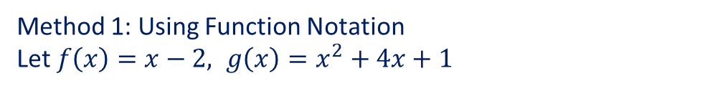
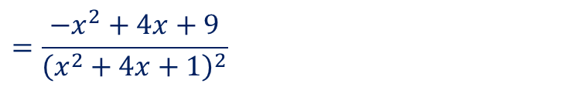
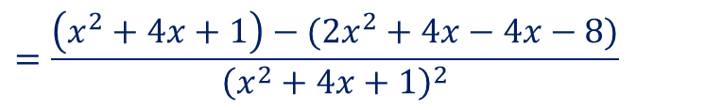
Guided Practice
Differentiate $y=\frac{\left(x−2\right)}{x^{2}+4x+1}$with respect to $x$
Method 1: Using Function Notation
Let $f\left(x\right)=x−2, g\left(x\right)=x^{2}+4x+1$
Method 2: Using Leibniz Notation
Let $u=x−2, v=x^{2}+4x+1$
$$f^{′}\left(x\right)=1, g^{′}\left(x\right)=2x+4$$
$$\frac{du}{dx}=1, \frac{dv}{dx}=2x+4$$
$$\frac{dy}{dx}=\frac{f^{′}\left(x\right)g\left(x\right)−f\left(x\right)g^{′}\left(x\right)}{g{\left(x\right)}^{2}}$$
$$\frac{dy}{dx}=\frac{v\frac{du}{dx}−u\frac{dv}{dx}}{v^{2}}$$
$$=\frac{\left(x^{2}+4x+1\right)−(x−2)(2x+4)}{{\left(x^{2}+4x+1\right)}^{2}}$$
$$=\frac{\left(x^{2}+4x+1\right)−(x−2)(2x+4)}{{\left(x^{2}+4x+1\right)}^{2}}$$
$$=\frac{\left(x^{2}+4x+1\right)−(2x^{2}+4x−4x−8)}{{\left(x^{2}+4x+1\right)}^{2}}$$
$$=\frac{\left(x^{2}+4x+1\right)−(2x^{2}+4x−4x−8)}{{\left(x^{2}+4x+1\right)}^{2}}$$
$$=\frac{−x^{2}+4x+9}{{\left(x^{2}+4x+1\right)}^{2}}$$
$$=\frac{−x^{2}+4x+9}{{\left(x^{2}+4x+1\right)}^{2}}$$

Slide 5
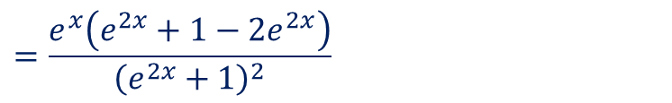

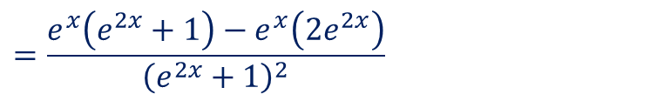
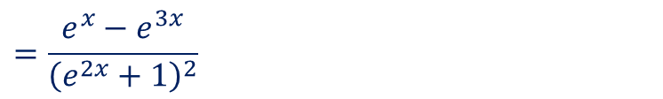
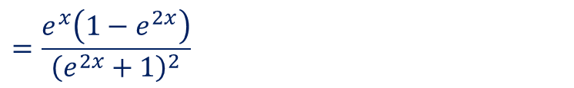
Guided Practice
Differentiate $y=\frac{e^{x}}{e^{2x}+1}$with respect to $x$
Let $f\left(x\right)=e^{x}, g\left(x\right)=e^{2x}+1$
$$f^{′}\left(x\right)=e^{x}, g^{′}\left(x\right)=2e^{2x}$$
$$\frac{dy}{dx}=\frac{f^{′}\left(x\right)g\left(x\right)−f\left(x\right)g^{′}\left(x\right)}{g{\left(x\right)}^{2}}$$
$$=\frac{e^{x}\left(e^{2x}+1\right)−e^{x}\left(2e^{2x}\right)}{{\left(e^{2x}+1\right)}^{2}}$$
$$=\frac{e^{x}\left(e^{2x}+1−2e^{2x}\right)}{{\left(e^{2x}+1\right)}^{2}}$$
$$=\frac{e^{x}\left(1−e^{2x}\right)}{{\left(e^{2x}+1\right)}^{2}}$$
$$=\frac{e^{x}−e^{3x}}{{\left(e^{2x}+1\right)}^{2}}$$

Slide 6

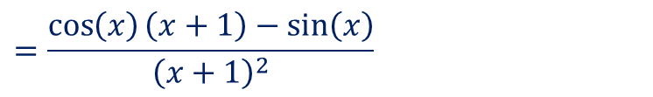
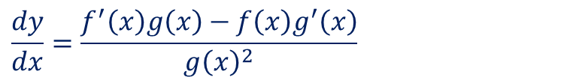
Guided Practice
Differentiate $y=\frac{sin (x)}{x+1}$with respect to $x$
Let $f\left(x\right)=\sin{(x)}, g\left(x\right)=x+1$
$$f^{′}\left(x\right)=\cos{(x)}, g^{′}\left(x\right)=1$$
$$\frac{dy}{dx}=\frac{f^{′}\left(x\right)g\left(x\right)−f\left(x\right)g^{′}\left(x\right)}{g{\left(x\right)}^{2}}$$
$$=\frac{\cos\left(x\right)\left(x+1\right)−\sin\left(x\right)}{{\left(x+1\right)}^{2}}$$

Slide 7
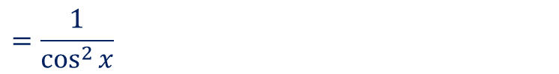
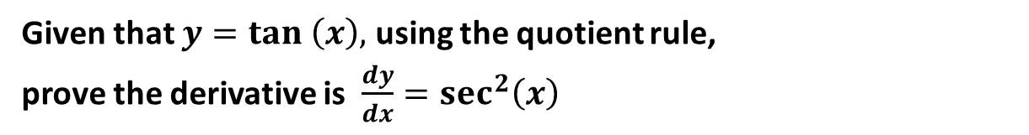
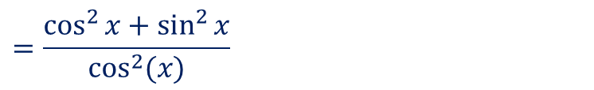

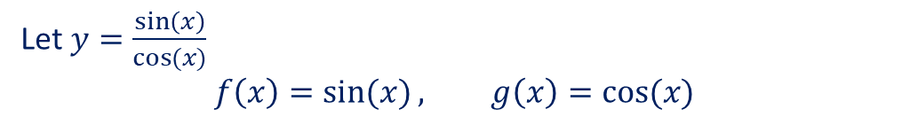
Guided Practice
Given that $y=tan \left(x\right),$ using the quotient rule,
prove the derivative is $\frac{dy}{dx}=sec^{2}\left(x\right)$
Let $y=\frac{\sin\left(x\right)}{\cos{(x)}}$
$$f\left(x\right)=\sin{(x)}, g\left(x\right)=\cos{(x)}$$
$$f^{′}\left(x\right)=\cos{(x)}, g^{′}\left(x\right)=−\sin{(x)}$$
$$\frac{dy}{dx}=\frac{f^{′}\left(x\right)g\left(x\right)−f\left(x\right)g^{′}\left(x\right)}{g{\left(x\right)}^{2}}$$
$$=\frac{\cos^{2}{x}+\sin^{2}{x}}{\cos^{2}{(x)}}$$
$$=\frac{1}{\cos^{2}{x}}$$
$$=\sec^{2}{x}$$

Slide 8
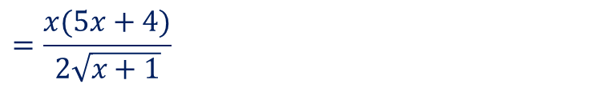
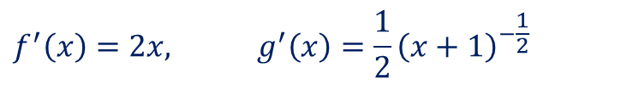
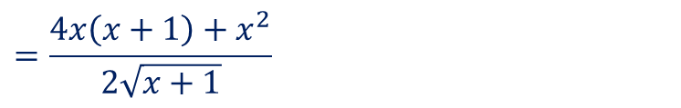
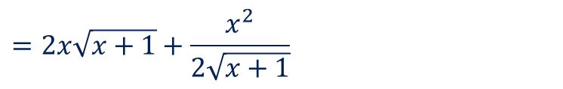
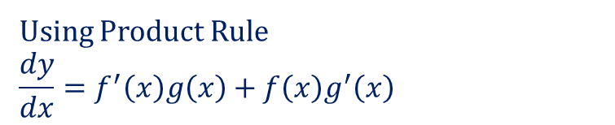
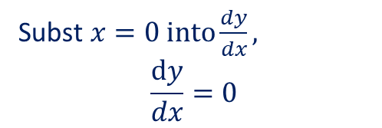

Guided Practice
Given the curve $y=x^{2}\sqrt{x+1}$, determine the y-coordinate and the gradient at the point where $x=0$
Subst$x=0 into y,$ $$y=0$$
Let $f\left(x\right)=x^{2}, g\left(x\right)=\sqrt{x+1}$
$$f^{′}\left(x\right)=2x, g^{′}\left(x\right)=\frac{1}{2}{\left(x+1\right)}^{−\frac{1}{2}}$$
Using Product Rule
$$\frac{dy}{dx}=f^{′}\left(x\right)g\left(x\right)+f\left(x\right)g^{′}\left(x\right)$$
$$=2x\sqrt{x+1}+\frac{x^{2}}{2\sqrt{x+1}}$$
$$=\frac{4x\left(x+1\right)+x^{2}}{2\sqrt{x+1}}$$
$$=\frac{x(5x+4)}{2\sqrt{x+1}}$$
Subst$x=0 into\frac{dy}{dx},$ $$\frac{dy}{dx}=0$$
$∴$ gradient of curve at point ($0,0)$ is $0$

Slide 9
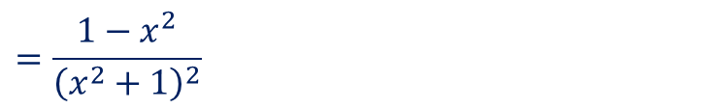
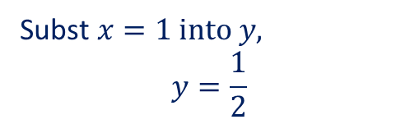
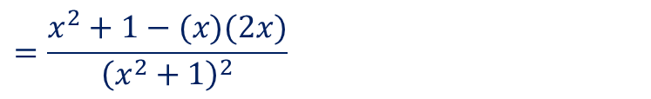
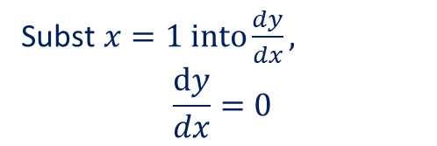
Guided Practice
Given the curve $y=\frac{x}{x^{2}+1}$, determine the y-coordinate and the gradient at the point where $x=1$
Subst$x=1 into y,$ $$y=\frac{1}{2}$$
Let $f\left(x\right)=x , g\left(x\right)=x^{2}+1$
$$f^{′}\left(x\right)=1, g^{′}\left(x\right)=2x$$
$\frac{dy}{dx}=\frac{f^{′}\left(x\right)g\left(x\right)−f\left(x\right)g^{′}\left(x\right)}{g{\left(x\right)}^{2}}$ (using Quotient Rule)
$$=\frac{x^{2}+1−(x)(2x)}{{\left(x^{2}+1\right)}^{2}}$$
$$=\frac{1−x^{2}}{{\left(x^{2}+1\right)}^{2}}$$
Subst$x=1 into\frac{dy}{dx},$ $$\frac{dy}{dx}=0$$
$∴$ gradient of curve at point $\left(1,\frac{1}{2}\right)$ is $0$

Slide 10
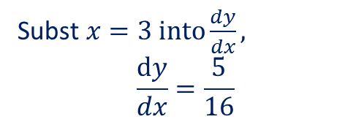

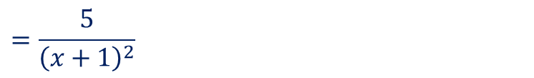

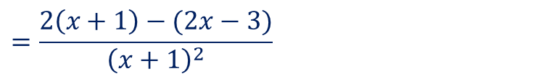



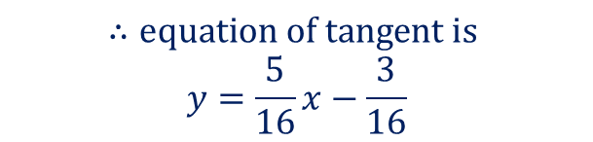
Guided Practice
Determine the equation of the tangent to the curve$y=\frac{2x−3}{x+1}$ at the point (3, 0.75)
Let $f\left(x\right)=2x−3 , g\left(x\right)=x+1$
$$f^{′}\left(x\right)=2, g^{′}\left(x\right)=1$$
$$∴y=\frac{5}{16}x+c$$
$\frac{dy}{dx}=\frac{f^{′}\left(x\right)g\left(x\right)−f\left(x\right)g^{′}\left(x\right)}{g{\left(x\right)}^{2}}$ (using Quotient Rule)
Substi $x=3, y=\frac{3}{4}into y=\frac{5}{16}x+c$
$$=\frac{2\left(x+1\right)−(2x−3)}{{\left(x+1\right)}^{2}}$$
$$\frac{3}{4}=\frac{5}{16}(3)+c$$
$$=\frac{5}{{\left(x+1\right)}^{2}}$$
$$c=\frac{12}{16}−\frac{15}{16}=−\frac{3}{16}$$
Subst$x=3 into\frac{dy}{dx},$ $$\frac{dy}{dx}=\frac{5}{16}$$
$$∴equation of tangent is$$
$$y=\frac{5}{16}x−\frac{3}{16}$$
Gradient of tangent at point = $\frac{5}{16}$

Slide 11


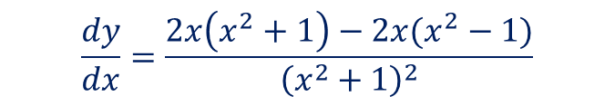
Guided Practice
Determine the equation of the tangent to the curve$y=\frac{x^{2}−1}{x^{2}+1}$ where$x=0$
Sub. $x=0$ into $y, y=−1$
$$\frac{dy}{dx}=\frac{2x\left(x^{2}+1\right)−2x(x^{2}−1)}{{\left(x^{2}+1\right)}^{2}}$$
$$=\frac{2x[x^{2}+1−x^{2}+1]}{{\left(x^{2}+1\right)}^{2}}$$
$$=\frac{4x}{{\left(x^{2}+1\right)}^{2}}$$
Sub. $x=0$ into $\frac{dy}{dx},\frac{dy}{dx}=0$
$∴$ equation of tangent$y=−1$

Slide 12
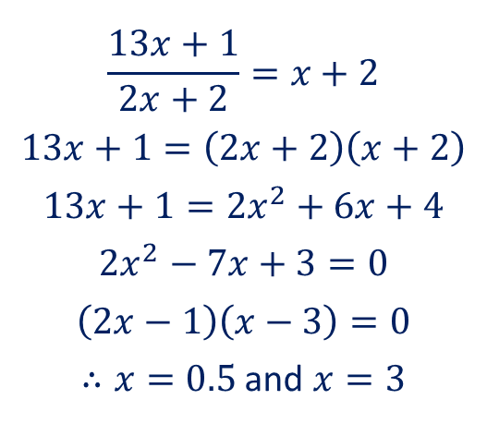
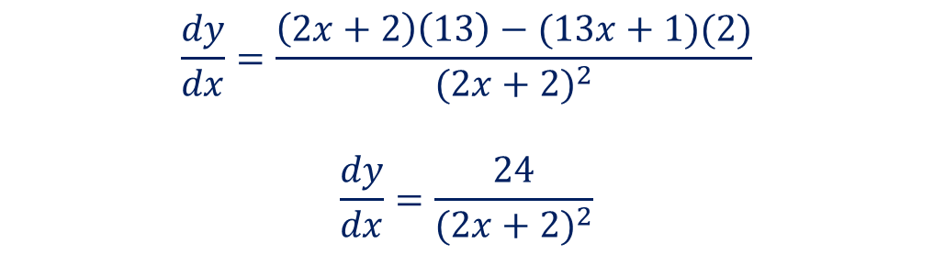
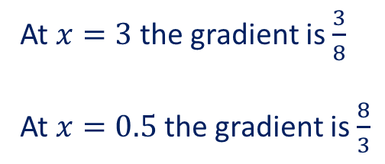
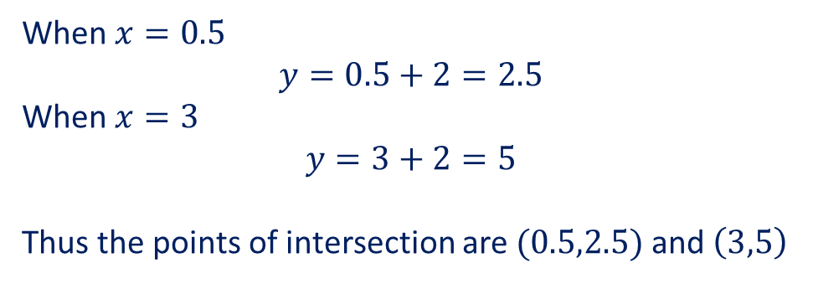
Guided Practice
Determine the gradient of $y=\frac{13x+1}{2x+2}$ at the points where the graph intersects the line
$y=x+2$ and state the coordinates of these points of intersection.
Equate equation to determine intersection points
Differentiate to determine gradient
$$\frac{13x+1}{2x+2}=x+2$$
$$13x+1=\left(2x+2\right)\left(x+2\right)$$
$$13x+1=2x^{2}+6x+4$$
$$2x^{2}−7x+3=0$$
$$\left(2x−1\right)\left(x−3\right)=0$$
$∴x=0.5$ and $x=3$
$$\frac{dy}{dx}=\frac{\left(2x+2\right)\left(13\right)−(13x+1)(2)}{(2x+2)^{2}}$$
$$\frac{dy}{dx}=\frac{24}{{(2x+2)}^{2}}$$
At $x=3$ the gradient is $\frac{3}{8}$
At $x=0.5$ the gradient is $\frac{8}{3}$
When $x=0.5$
$$y=0.5+2=2.5$$
When $x=3$
$$y=3+2=5$$
Thus the points of intersection are$(0.5,2.5)$ and $\left(3,5\right)$

Slide 13
Independent Practice
Complete Cambridge Ex 4K Except Q4C and 5

